Slide 1
Making LLMs more Specialized & Practical Fine Tuning, Pruning, Quantizing, Distilling
Dr. Sreerama K. Murthy
22nd April 2026

Slide 2
Yesterday ...
What is the physical architecture of a Large Language Model?
How is text fed into it? (embedding, encoding)
What training prepares a transformer into a foundation model?

Slide 3
Today…
Except as public intelligence infrastructure, LLMs are too general-purpose and too big – hence guzzling too much data, compute, energy, funds, etc. Hence..
How to convert foundation models into specialists? (Fine tuning)
How to fine tune efficiently?
What techniques are available to shrink LLMs into Small LMs, Mini LMs, Micro LMs, Nano LMs?
Pruning
Quantization
Distillation

Slide 4
Fine-Tuning & PEFT
When prompts aren’t enough… teach the model new behavior

Slide 5
What Is The Need For Finetuning?
In-context learning may not be able to include enough data samples to describe the problem well.
In-context learning may not work for smaller LLMs
Examples take up space in the context window.
While LLM may be good with natural language understanding and generation, task can be specific.
Conversations; Code generation; Summarization; Sentiment analysis
Finetuned small language models (SLMs) can perform very well.

Slide 6
Why Fine-tune An LLM?
Prompting = surface-level control
Fine-tuning = embed knowledge or style into the model
Prompting (temporary fix) vs Fine-Tuning (permanent learning)
Start with prompting. Use RAG if the model needs external knowledge. Use fine-tuning when the model itself needs to change how it behaves.

Slide 7
LLM finetuning (high-level)
Training data (GB - TB – PB of unstructured textual data)
Pre-trained LLM
LLM pretraining

Slide 8
LLM Finetuning (contd.)
Task-specific examples
[Text, label/response], [Text, label/response], [Text, label/response], [Text, label/response], [Text, label/response],
…
Pre-trained LLM
Fine-tuned LLM
LLM Finetuning

Slide 9
Using Prompts To Fine-tune LLMs
Task-specific examples
Task specific data [Prompt, completion], [Prompt, completion], [Prompt, completion], [Prompt, completion], [Prompt, completion],
…
Pre-trained LLM
Fine-Tuned LLM
LLM Finetuning

Slide 10
Using prompts to fine-tune LLMs
Task-specific examples
Classify this review: I loved this DVD!
Sentiment: Positive
Classify this review: I don’t like this chair.
Sentiment: Negative
Pre-trained LLM
Fine-tuned LLM
LLM Finetuning

Slide 11
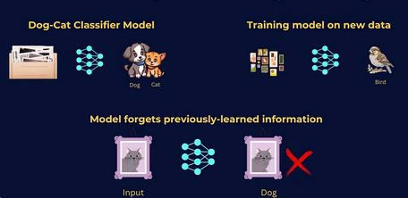
Effect Of Tuning On A Single Task
Catastrophic forgetting
Only few thousand samples needed for finetuning on a task.
Learning on a single task with less
data can lead to reduction in ability
on other tasks

Slide 12
Multi-task finetuning of LLM
Summarize the following text:
Rate this review:
Pre-trained LLM
Fine-tuned LLM
Translate into Python code:
Identify the places:
LLM Finetuning

Slide 13
PEFT
Parameter Efficient Fine Tuning

Slide 14
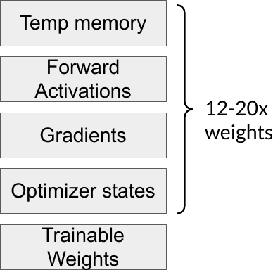
Full fine-tuning of large LLMs is challenging
Full finetuning requires large number of computational resources.
GPU memory requirement is equivalent to training the LLM from scratch.
High budget implications.
Need to create a large finetuned LLM per task or a group of tasks.

Slide 15
Parameter Efficient Fine-tuning (PEFT)
Only train a small set of additional parameters of the LLM
Most layers of the LLM are frozen
Less prone to catastrophic forgetting
Less storage requirement
Computationally less expensive
Less budget requirement

Slide 16
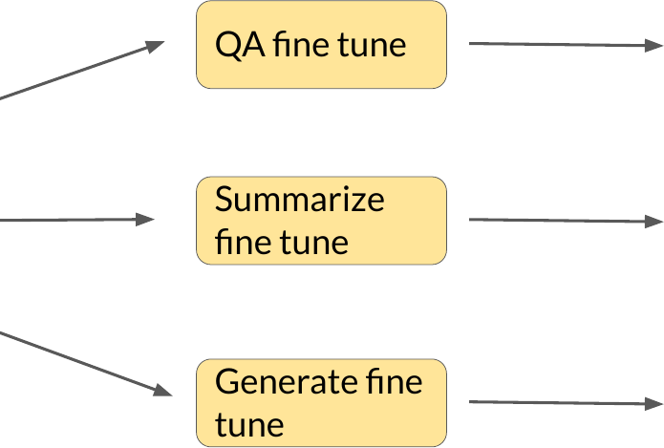
Finetuning creates a full copy of the LLM
QA LLM
LLM
Summarize LLM
Generate LLM

Slide 17
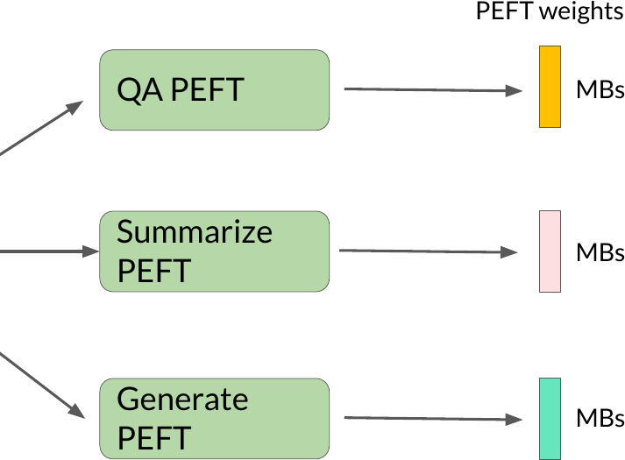
PEFT finetuning saves cost and storage
Summarize LLM
LLM

Slide 18
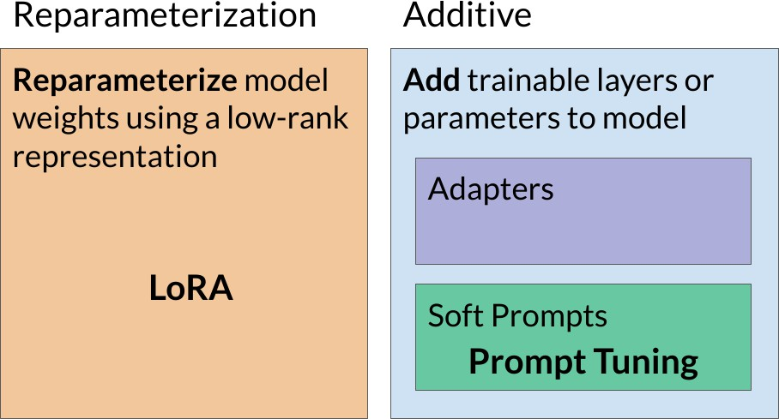
PEFT Methods

Slide 19
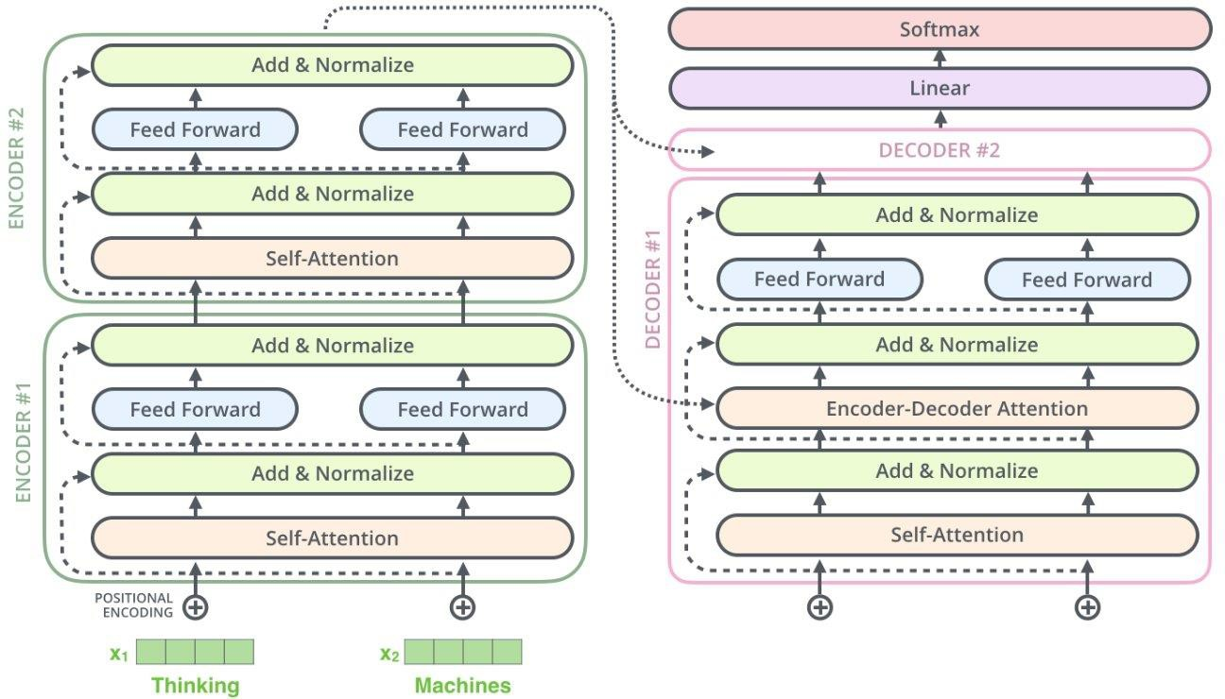
Transformers Recap

Slide 20
Transformers Recap
FCN
weights
Attention weights

Slide 21
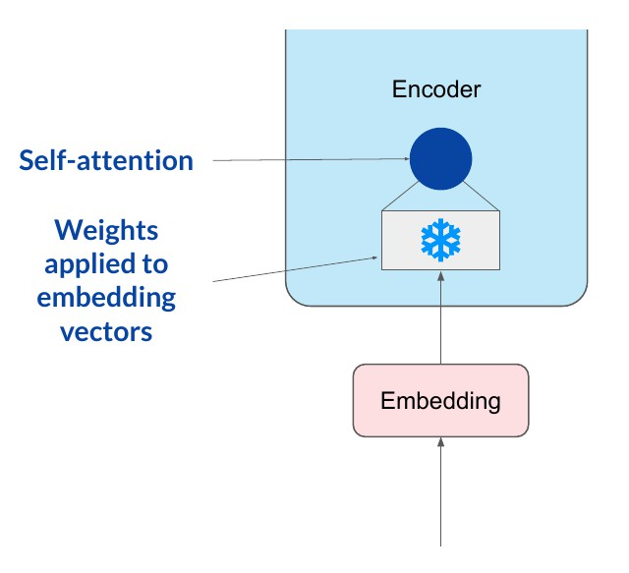
LoRA: Low Rank Adaption of LLMs
Step-1: Freeze most of the weights of the LLM. For example, the attention weights and the FCN weights.

Slide 22
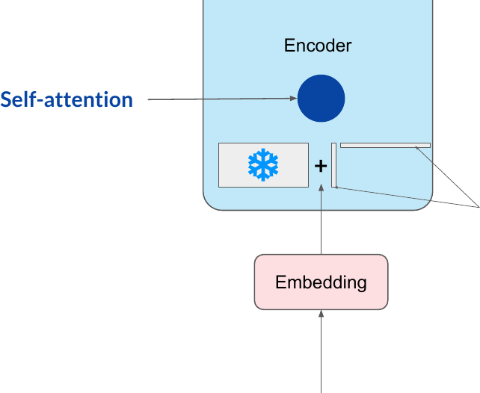
LoRA: Low Rank Adaption of LLMs
Step-1: Freeze most of the weights of the LLM. For example, the attention weights and the FCN weights.
Step-2: introduce 2 rank decomposition matrices
Rank r is small dimension.
Typically, 4, 8 ... 64

Slide 23

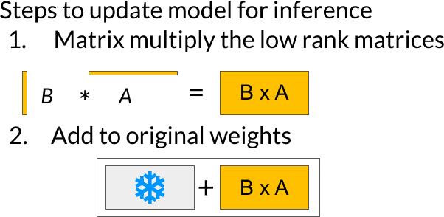
LoRA: Low Rank Adaption of LLMs
Step-1: Freeze most of the weights of the
LLM. For example, the attention weights and the FCN weights.
Step-2: introduce 2 rank decomposition
matrices.
Step-3: Train the weights of the smaller matrices
Rank r is small dimension.
Typically, 4, 8 ... 64

Slide 24
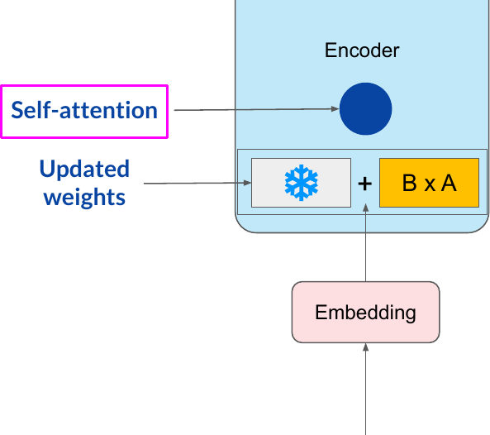
LoRA: Low Rank Adaption of LLMs
Step-1: Freeze most of the weights of the
LLM. For example, the attention weights and the FCN weights.
Step-2: introduce 2 rank decomposition
matrices.
Step-3: Train the weights of the smaller matrices

Slide 25
Lora: Parameter Reduction Example
Query matrix from BERT second encoder layer has dimensions d x k = 768 x 768
So, 768 x 768 = 5,89,824 trainable parameters
In LoRA with rank r = 32:
A has dimensions r x k = 32 x 768 = 9216 parameters
B has dimension d x r = 768 x 32 = 9216 trainable parameters
92% reduction in parameters to train!

Slide 26
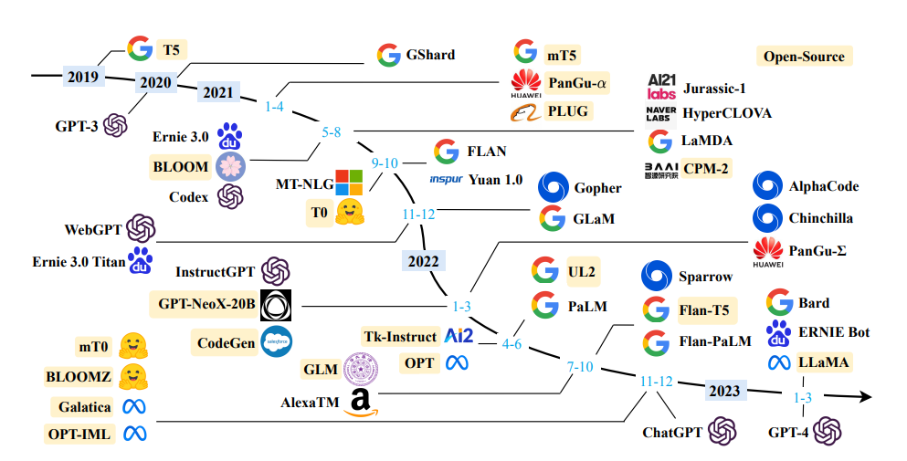
Sample Fine-Tuned (Open Sourced) Models
https://sungkim11.medium.com/list-of-open-sourced-fine-tuned-large-language-models-llm-8d95a2e0dc76

Slide 27
Neural Scaling

Slide 28
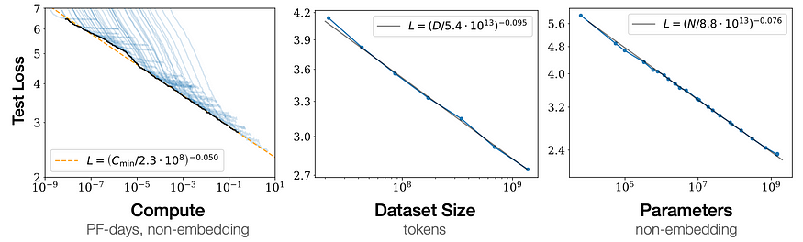
Neural Scaling Laws
https://www.youtube.com/watch?v=5eqRuVp65eY

Slide 29
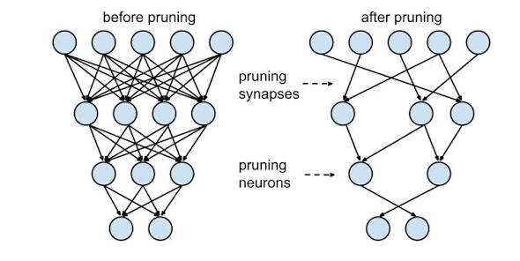
Pruning LLMs
LLM pruning reduces the size & compute cost by removing redundant or less important parameters - weights, neurons, or layers.
It boosts inference speed, lowers memory consumption, and makes models more efficient for deployment.
Structured pruning removes structural components (neurons, channels, layers). Useful for edge deployment.
Unstructured pruning removes individual, non-essential weights, creating sparse matrices. Often requires specialized hardware for acceleration.
Depth pruning removes complete transformer layers, often at the middle or end, while width pruning narrows the hidden layers.

Slide 30
Quantization

Slide 31
Model Size Reduction
Most LLMs have billions of parameters → slow, memory-hungry.
Inference cost is high, especially for cloud and edge deployment.
Memory constraints limit fine-tuning on smaller GPUs.
Latency can be a bottleneck for real-time applications.
Solution: Compress the model without sacrificing much performance.

Slide 32
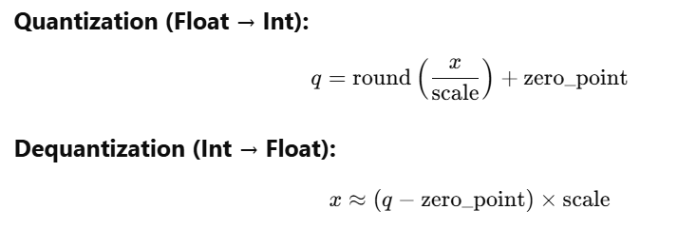
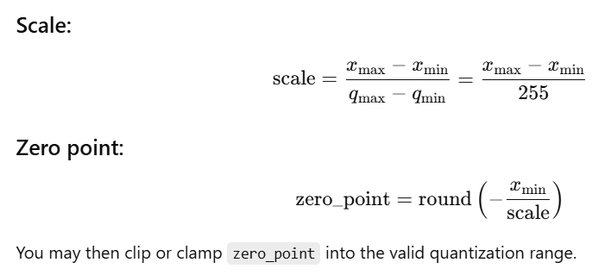
Smaller LLMs: Quantization
Term | Meaning
x | Original float value
q | Quantized integer
scale | Floating-point step size between quantized levels
zero_point | Integer that maps float zero to a quantized value (usually in int range)

Slide 33
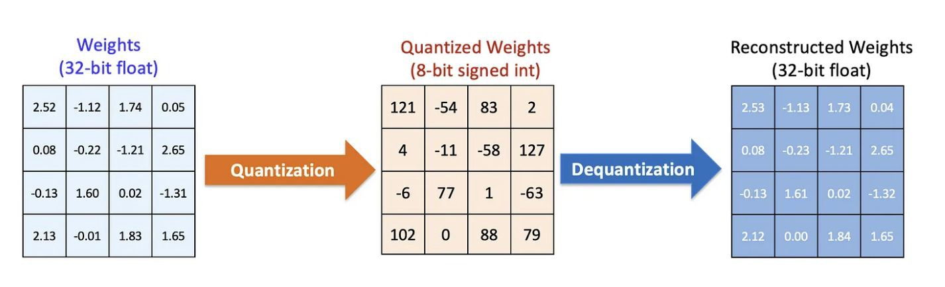
Quantization
Quantization helps reduce the memory footprint of a model by storing numbers in 8-bit or 4-bit format instead of 32-bit floats.
For example, a 7B parameter model at FP32 takes ~28 GB; INT4 brings it down to ~3.5–4 GB. The tradeoff is slightly lower accuracy, but often acceptable.

Slide 34
Model size vs Quantization
 | 16-bit memory | 8-bit memory | 4-bit memory
LLaMA-7B | 14 GB | 7 GB | 3.5 GB
LLaMA-13B | 26 GB | 13 GB | 6.5 GB
LLaMA-30B | 60 GB | 30 GB | 15 GB
LLaMA-70B | 140 GB | 70 GB | 35 GB
GP3-175B | 350 GB | 175 GB | 87.5 GB

Slide 35
Is Quantization a no-brainer, then?
At the moment, YES!
4x-8x reduction in RAM
Certain implementations using integer math can be faster by 2-3x on most accelerators
Use of powerful models on EDGE devices possible

Slide 36
QLoRA = Quantized Model + LoRA Adapters
QLoRA uses 4-bit quantized weights for the base LLM → drastically reduces memory.
Adds LoRA adapters for efficient fine-tuning → no need to update full weights.
LoRA adapters are trained in full precision; only base model is quantized.
Enables training of models like LLaMA-7B on a single 24GB GPU.
Matches or exceeds full fine-tuning performance — at a fraction of cost and resources.

Slide 37
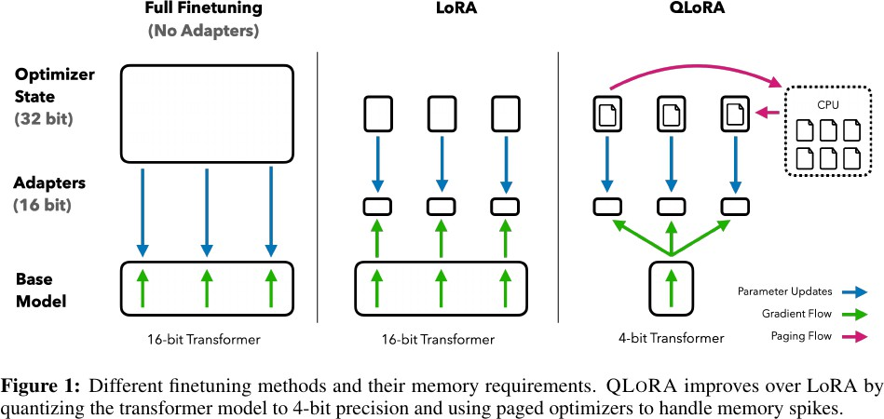
QLoRA: Quantized LoRA
Introduces 4-bit NormalFloat (nf4) data type for 4-bit quantization
Supports double- quantization to reduce memory ~0.4 bits per parameter
LoRA adapters at every layer - not just attention layers.

Slide 38
Distillation

Slide 39
Model Distillation
A “student model” learns to mimic the outputs of a larger “teacher model”.
Transfers knowledge from large models to smaller ones — fewer parameters, faster inference.
Often used to compress models for real-time or mobile deployment.
The student model learns from both: Ground truth labels; Teacher’s logits or soft outputs (which carry richer info)
Can preserve accuracy surprisingly well.

Slide 40
Sample List of Distilled Models 2024-26
DeepSeek-R1-Distill-Qwen-1.5B/7B/14B/32B
DeepSeek-R1-Distill-Llama-8B/70B
Phi-4-mini (3.8B)
Phi-3-mini (3.8B)
Gemma-2-9B-IT
Gemma-2-27B-IT
LaMini-LM
Zephyr-7B-α and β
Orca 2 (7B/13B)
DistilBERT and derivatives (e.g., DistilGPT2)
Tiny Aya (3.35B)
Marcoroni-70B
30% lesser parameters
50% faster
Retain ~ 95% accuracy

Slide 41
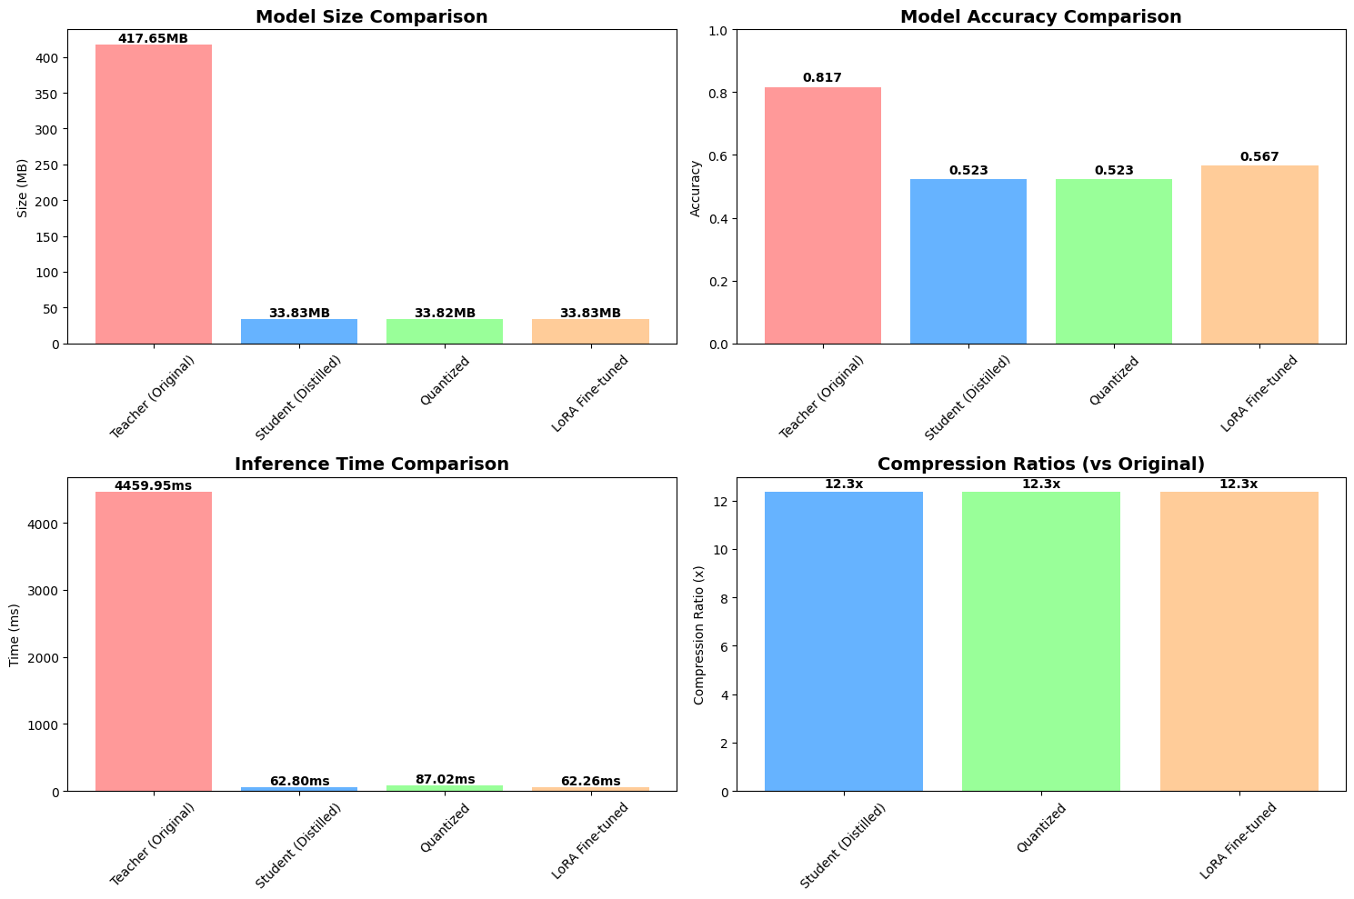
Distilled Model Performance
DistilBERT (66M) + 8-bit quantization → ~15MB model Used in mobile NLP apps (e.g., Snips Voice Assistant) for fast, offline inference with minimal accuracy loss.

Slide 42
Decision Matrix
When to use what

Slide 43
Distillation vs Quantization
Feature | Distillation | Quantization
What it does | Trains a small model to mimic a large model | Reduces weight precision (e.g., FP32 → INT4)
Model Architecture | Student model is separate from teacher | Model architecture remains the same
Training Needed | ✅ Yes – Student needs to be trained | ❌ No (Post-training quantization is common)
Accuracy Impact | Moderate loss (can be minimized) | Slight accuracy drop depending on bits used
Use Case | Create fast, lightweight inference models | Deploy large models on small hardware
Combines With | PEFT, task-specific tuning | LoRA (→ QLoRA), on-device models

Slide 44
Choosing the right model optimization technique
Scenario / Need | Best Method | Why
Want lowest latency + smallest memory footprint | Quantization (4-bit / 8-bit) | Massive RAM reduction, deploy on low-cost GPUs/edge devices
Want small model that behaves like a big model | Distillation | Student captures teacher behavior; fast inference
Want to add new behavior, style, or output patterns | PEFT / LoRA | Efficient weight updates, minimal compute, preserves base LLM
Want to fine-tune quantized model on limited GPU (e.g., 24GB) | QLoRA | Full finetuning performance on 4-bit model
Need domain-context answers, but not new model behavior | RAG (next module) | External knowledge → no model changes
Need full weights updated for highly specialized tasks | Full Finetuning | Maximum flexibility, but highest compute/storage cost
Most enterprise tasks can be solved with Quantization + LoRA / QLoRA. Full finetuning is rarely needed today

Slide 45
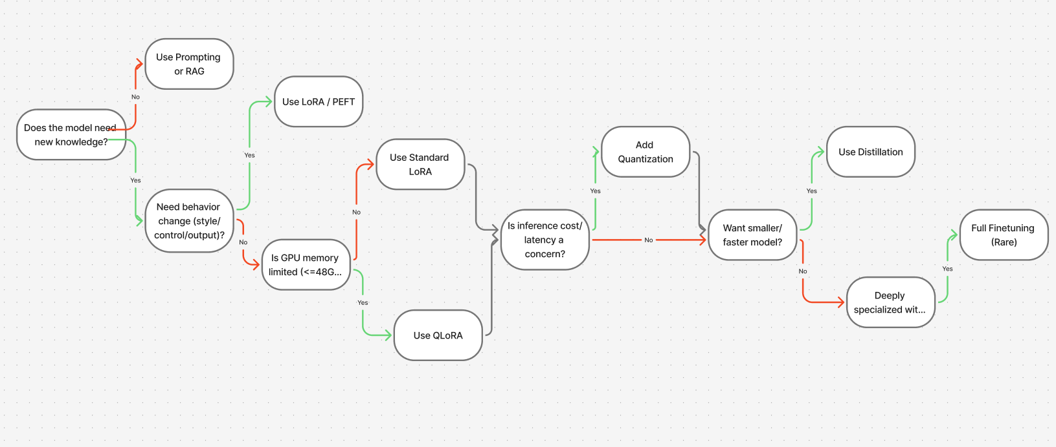
Practical Decision Flow for Enterprises

Slide 46
Thank You
We appreciate your time and look forward to your feedback on the session.
Contact us: TekFrameworks Consulting | info@tekFrameworks.com | www.tekFrameworks.com
Confidentiality Notice: This proposal is proprietary to TekFrameworks Consulting Pvt. Ltd. and is intended solely for the Client’s evaluation. It may not be shared with third parties. The contents are non-binding; any engagement will be governed by a separate written agreement. For Client Use Only | TekFrameworks Consulting Pvt. Ltd.| © 2025 TekFrameworks

